Slide 1
ChatRelay Final Phase
Kenny Kottenstette, Talhah Shaik, Zoheb Sharif

Slide 2
Classes

Slide 3
Abstract User User IT Admin
Represents an account in the system.
Stores personal data like name, username, password.
Contains unique ID.
Tracks associated chat rooms
Associates users with their conversations.

Slide 4
Chat
Represents a conversation room in the messaging system.
Stores a unique ID, room name, and list of chatters.
Supports public and private chat rooms, where privacy affects who can add new members.
Used when creating or loading chat sessions from file.
Chats hold User and Message objects.

Slide 5
Message
Represents individual text messages in the chat system
Tracks unique message ID via a static counter
Stores a timestamp at the time of creation, content, sender, and destination chat
Associates messages with both sender and chat room

Slide 6
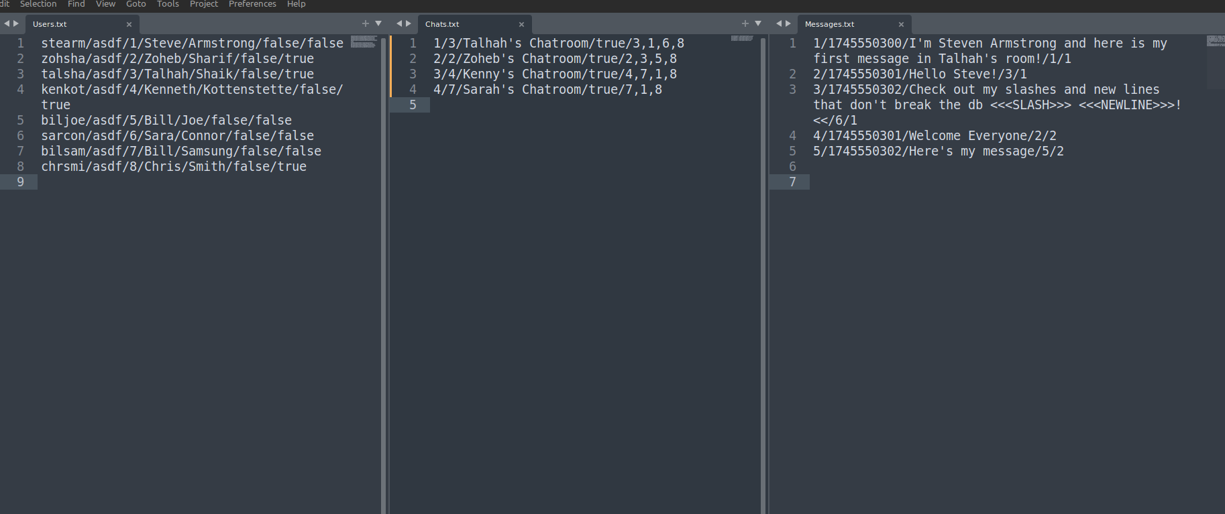
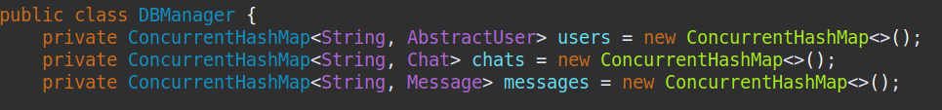
Users, Chats, Messages Text Files

Slide 7
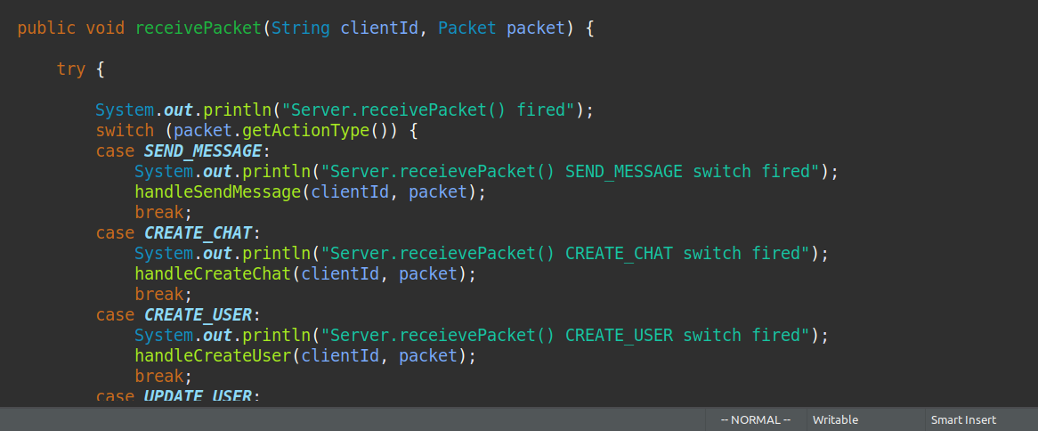
Server

Slide 8
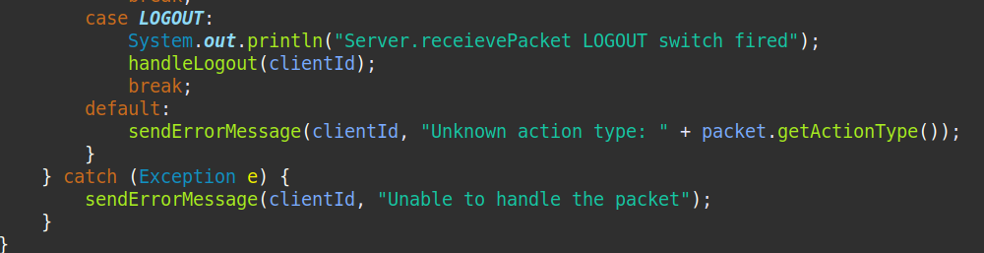
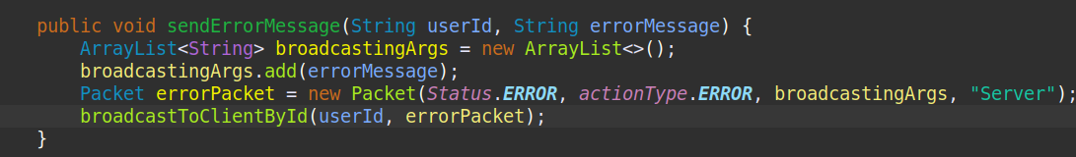
Server

Slide 9
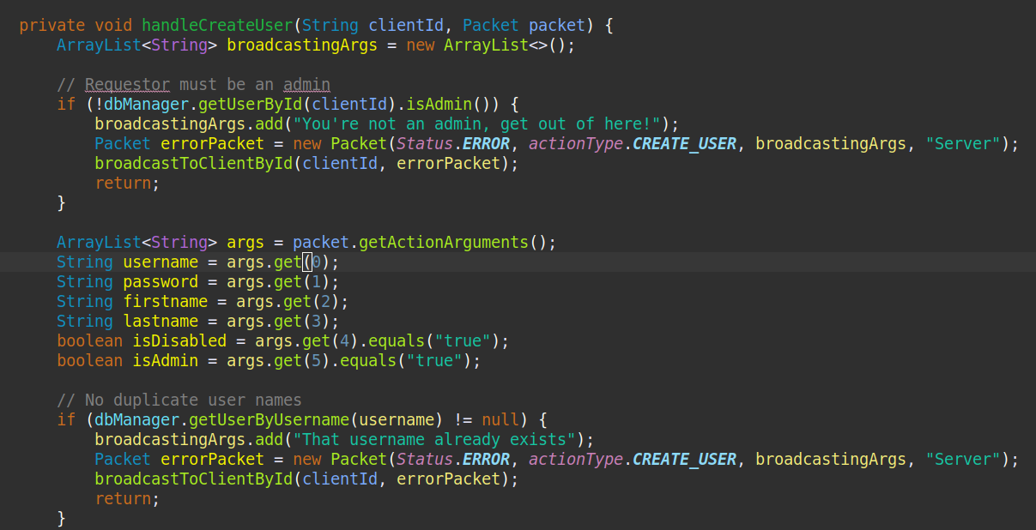
Server.handleCreateUser()

Slide 10
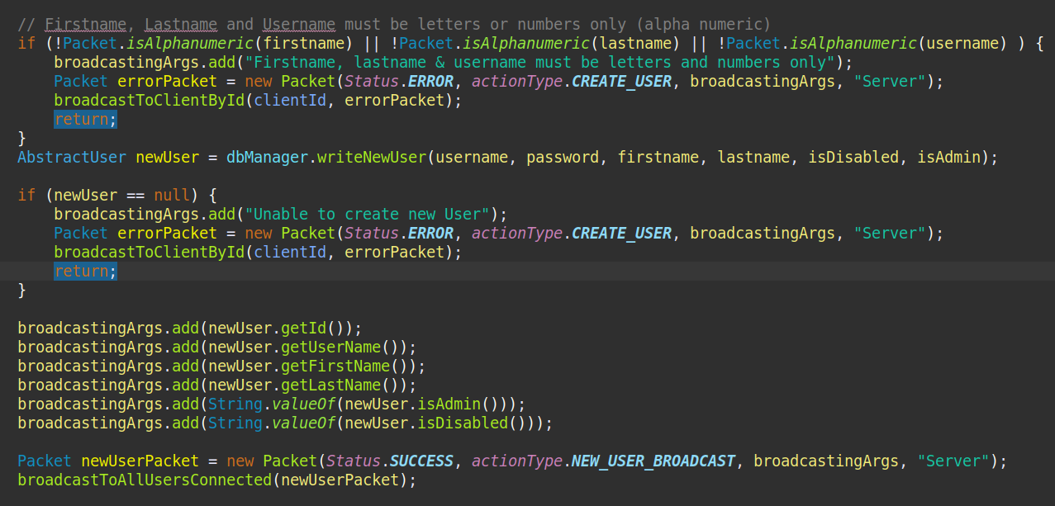
Server.handleCreateUser()

Slide 11
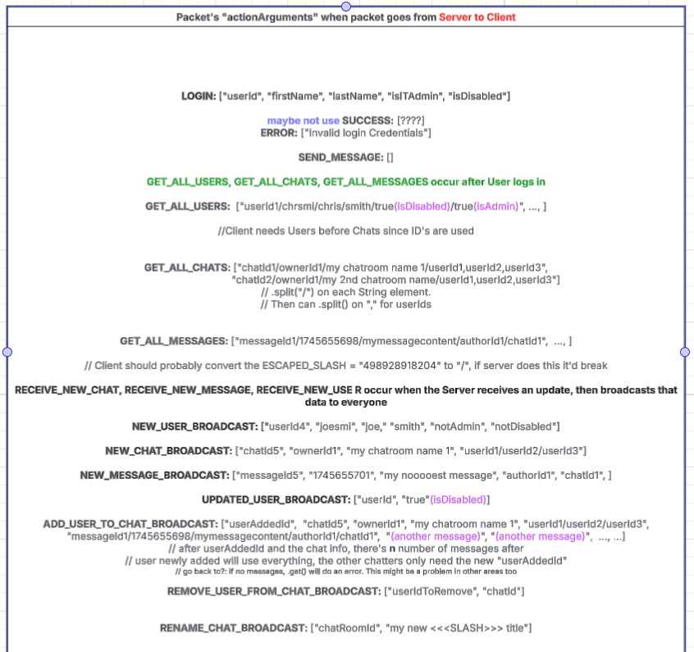
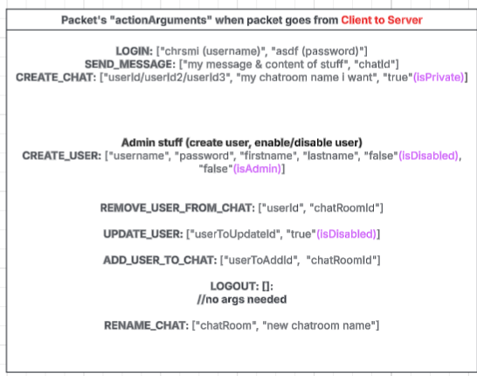
Packet

Slide 12
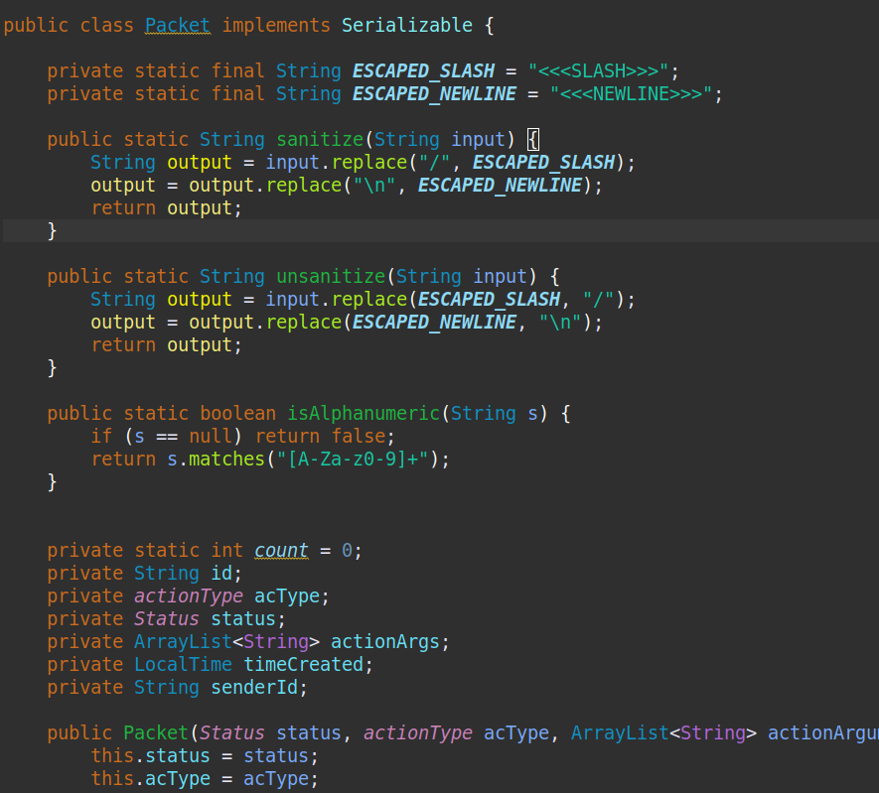
Packet

Slide 13
Client
Login
Authenticated user based on provided credentials
Send Message
Sends a message to specified chat.
Create Chat
Creates a new Chat with selected Users.
Update State
Refreshes client’s current data.
Save Chat To Text (Admin)
The ability to download the current Chat logs to your system
Logout
Logs the User out and closes the session.
Client Input (Class) Handles all incoming Packets from the server and updates GUI as needed.

Slide 14
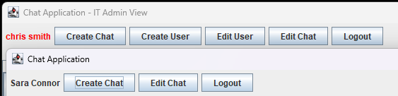
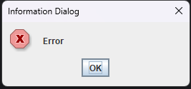
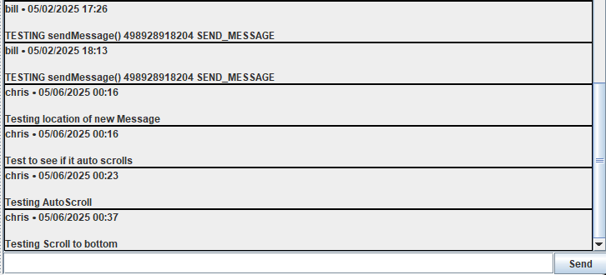
GUI
Different Views
Instant Updates
Dialog Messages
Based on the current
User the GUI shows a
different set of Actions
Any new changes are
immediately shown in
the GUI
Any action that requires
an approval of the Server
is sent a Dialog Message

Slide 15
Unit Testing

Slide 16
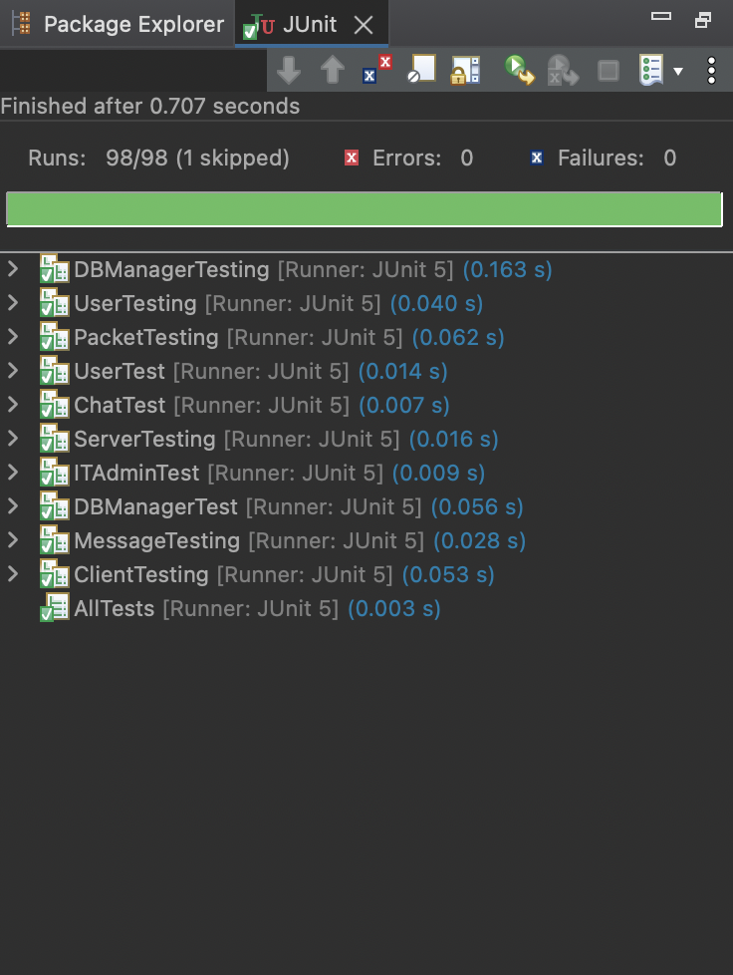
Unit Testing
Uses JUnit framework for automated test execution.
There exists a testing suite in AllTests.java that acts as a driver for all tests in the system.
Covers normal operations, as well as robust operations.

Slide 17
Performed extensive testing for the following classes:
01
02
03
04
05
06
07
08
Chat
Client
DBManager
User
Message
Packet
Server
ITAdmin
* Includes test socket stubs to simulate network connections

Slide 18
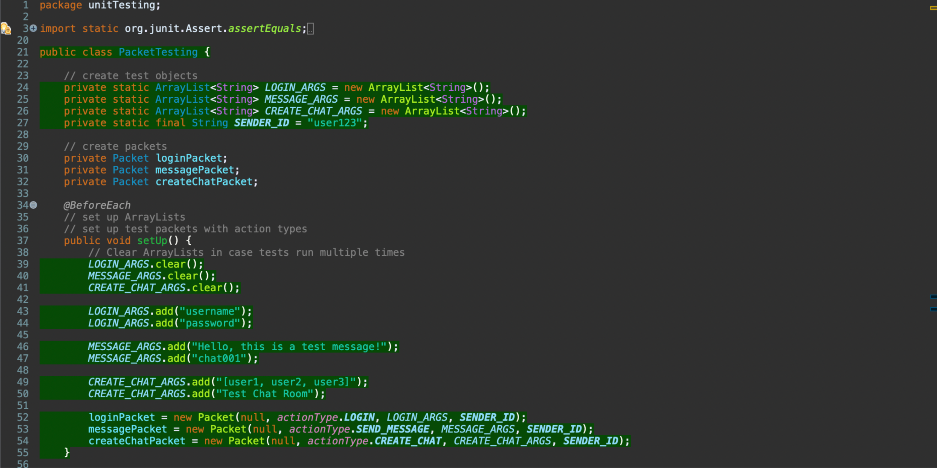
Unit Testing Example

Slide 19
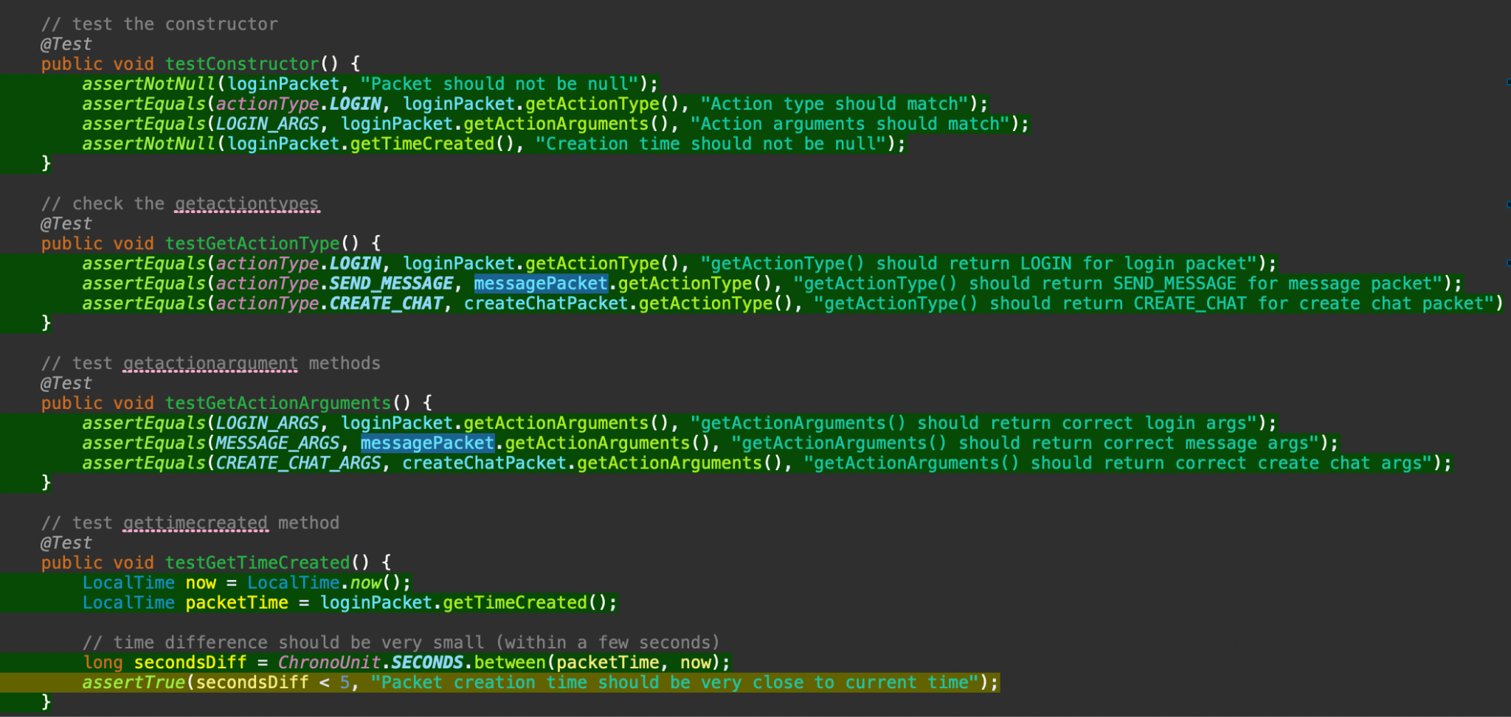
Unit Testing Example

Slide 20
Major Changes / Incomplete
Added Renaming Chats
Added new set of Enums to handle different actions between the Server and Clients
Added Packet Sanitize/Unsanitize
Functionality for the Edit Chat Button is incomplete

Slide 21
Demo Time!

